Slide 1
Population & Human Resources
By
Chowdhury Mujaddid Ahmed

Slide 2

Bangladesh Population
The current population of Bangladesh is 172,699,175 based on projections of the latest United Nations data. The UN estimates the July 1, 2023 population at 172,954,319.

Slide 3
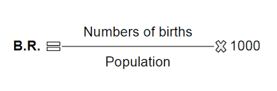
Birth rate calculation
Birth rate: Calculated by dividing the number of live births in a population in a year by the midyear resident population.

Slide 4
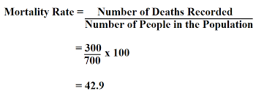
Mortality rate calculation
The estimated total number of deaths in a population of a given sex and/or age, divided by the total number of this population, expressed per 100,000 population, for a given year, in a given country, territory, or geographic area.

Slide 5
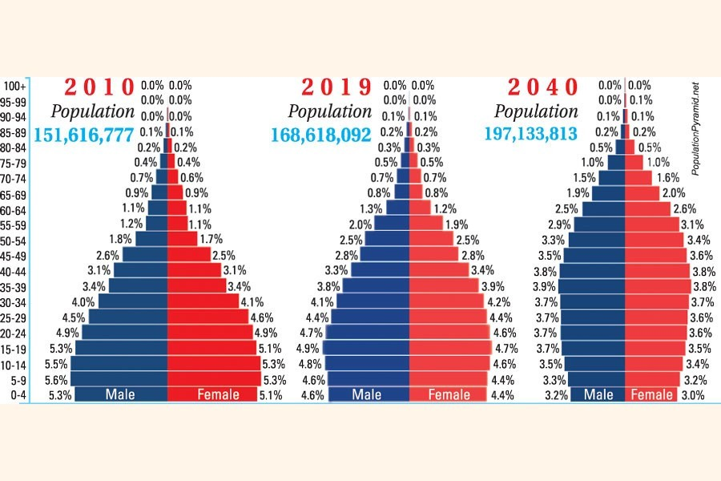
Demographic Dividend
Demographic dividend refers to the growth in an economy that is the result of a change in the age structure of a country’s population. The change in age structure is typically brought on by a decline in fertility and mortality rates.

Slide 6

Human Resource
Human resources (HR) is the division of a business that is charged with finding, recruiting, screening, and training job applicants. It also administers employee benefit programs.

Slide 7
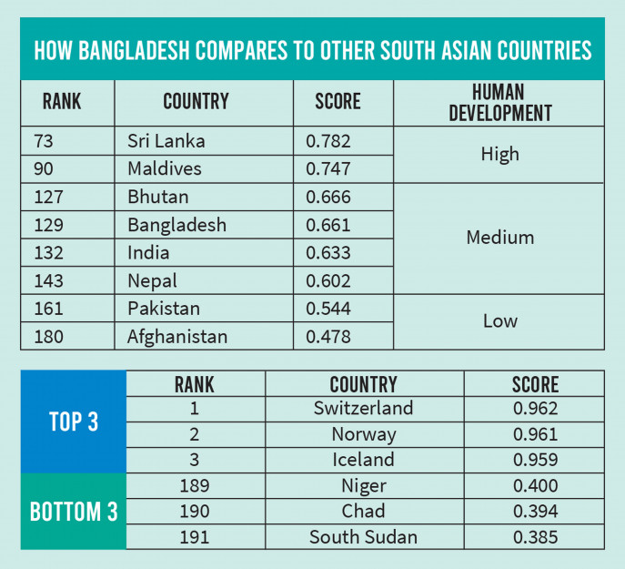
The prospect of Bangladesh’s Human Resource
With a current value of 0.661, it ranks at 129 out of 191 countries and places among medium human-development countries. Bangladesh is also one of South Asia's better performers, with its HDI value above the regional value of 0.632.

Slide 8
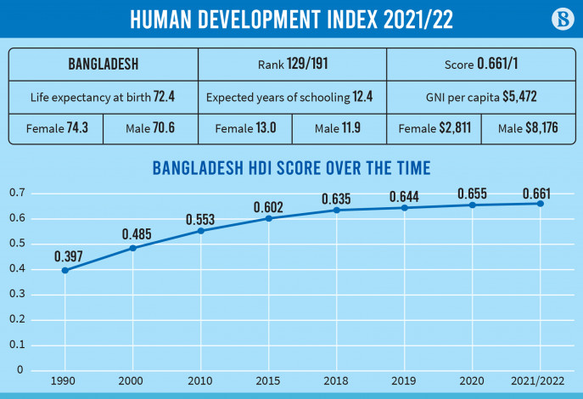
The prospect of Bangladesh’s Human Resource

Slide 9
Thank you
End
of
Lecture

